Slide 1

The Dormand-Prince method

Slide 2
Introduction
In this topic, we will
Derive and describe the adaptive Dormand-Prince method
Look at the implementation
See two examples

Slide 3
Recap of 4th-order Runge-Kutta
Given (t_{k}, y_{k}), the 4th-order Runge-Kutta method sampled the slope four times:
Note that two samples were inside the interval [t_{k}, t_{k} + h]
We then took a weighted average of these slopes:

Slide 4
Dormand-Prince method
Given (t_{k}, y_{k}), the method sampled the slope seven times:

Slide 5
Dormand-Prince method
Important:
For a single step, the error of the approximation z is O(h⁶)
The literature refers to this one as fifth-order
This is similar to referring to 4th-order Runge-Kutta which is actually O(h⁵) for a single step
Similarly, a single step of the approximation y is O(h⁵)

Slide 6
Dormand-Prince method
From analysis, y has an O(h⁵) error
Solving this for C yields:
We want to choose the ideal ah so that the error is ε_{abs}(ah)
Solving this for a yields
Substituting in the approximation of C from above:

Slide 7
Implementation
The implementation requires a few constants
std::size_t const DIM{7};
double step[DIM - 1]{
1.0/5.0, 3.0/10.0, 4.0/5.0, 8.0/9.0, 1.0, 1.0
};
double tableau[DIM - 1][DIM - 1]{
{ 1.0 },
{ 1.0/4.0, 3.0/4 },
{ 11.0/9.0, -14.0/3.0, 40.0/9.0 },
{ 4843.0/1458.0, -3170.0/243.0, 8056.0/729.0, -53.0/162.0 },
{ 9017.0/3168.0, -355.0/33.0, 46732.0/5247.0, 49.0/176.0, -5103.0/18656.0 },
{ 35.0/384.0, 0.0, 500.0/1113.0, 125.0/192.0, -2187.0/6784.0, 11.0/84.0 }
};
double y_coeff[DIM]{
5179.0/57600.0, 0.0, 7571.0/16695.0, 393.0/640.0, -92097.0/339200.0, 187.0/2100.0, 1.0/40.0
};

Slide 8
Implementation
The implementation is only slightly more complex:
do {
double s[DIM]{ qdy.back() };
double z{};
for ( std::size_t i{0}; i < DIM - 1; ++i ) {
double slope{0.0};
for ( std::size_t j{0}; j <= i; ++j ) {
slope += tableau[i][j]*s[j];
}
z = qy.back() + h*step[i]*slope;
s[i + 1] = f( qt.back() + h*step[i], z );
}

Slide 9
Implementation
double slope_y{0.0};
for ( std::size_t i{0}; i < DIM; ++i ) {
slope_y += y_coeff[i]*s[i];
}
double y{ qy.back() + h*slope_y };
double a{ std::pow(
eps_abs*h/(2.0*std::abs( z - y )), 0.25
) };
if ( (a > 1.0) || (h == h_rng.first) ) {
qt.push( qt.back() + h );
qy.push( z );
qdy.push( f( qt.back(), z ) );
found = true;
}
a *= 0.9;

Slide 10
Implementation
On slide 4, we represent the calculations as:
In the implementation, you will note it appears as
You may be tempted to do the following:
Issue: if h is small, this may result in a sum of denormalized numbers, which will magnify the error

Slide 11
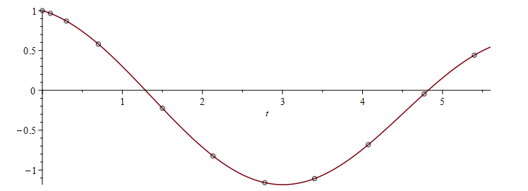
Example
Suppose we have
With h_{min} = 0.01 , h_{max} = 1 and ε_{abs} = 0.00001, we have
Now, the maximum h_{max} is more relevant, as we are using cubic splines to approximate values between these approximations

Slide 12
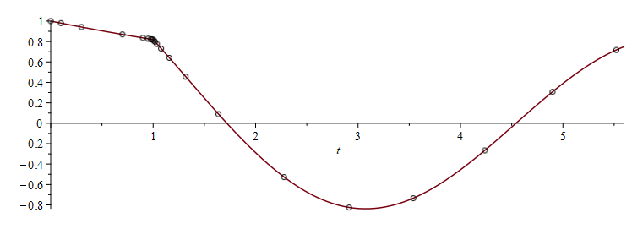
Example
Suppose we have
With h_{min} = 0.01 , h_{max} = 1 and ε_{abs} = 0.00001, we have

Slide 13
Summary
Following this topic, you now
Understand the adaptive Dormand-Prince method
Are aware of the calculations required
Know the derivation of the appropriate scaling factor a
Have seen the implementation
Have seen two examples

Slide 14
References
[1] https://en.wikipedia.org/wiki/Dormand-Prince_method
[3] https://en.wikipedia.org/wiki/Adaptive_algorithm
[4] https://en.wikipedia.org/wiki/Adaptive_step_size

Slide 15
Acknowledgments
Tazik Shahjahan for pointing out typos.
Aristedes Jose B. Aquino Jr. from YouTube who pointed out that one of the coefficients on Slide 4 had ··· – 64000s₂ + ··· and not ··· + 64000s₂ + ···
The subsequent Matlab code has the correct sign

Slide 16



Colophon
These slides were prepared using the Cambria typeface. Mathematical equations use Times New Roman, and source code is presented using Consolas. Mathematical equations are prepared in MathType by Design Science, Inc.
Examples may be formulated and checked using Maple by Maplesoft, Inc.
The photographs of flowers and a monarch butter appearing on the title slide and accenting the top of each other slide were taken at the Royal Botanical Gardens in October of 2017 by Douglas Wilhelm Harder. Please see
https://www.rbg.ca/
for more information.

Slide 17
Disclaimer
These slides are provided for the ece 204 Numerical methods course taught at the University of Waterloo. The material in it reflects the author’s best judgment in light of the information available to them at the time of preparation. Any reliance on these course slides by any party for any other purpose are the responsibility of such parties. The authors accept no responsibility for damages, if any, suffered by any party as a result of decisions made or actions based on these course slides for any other purpose than that for which it was intended.

